Slide 1

Section C
WIND ENERGY PREDICTION USING AI
Students Details:
Student 1 : POLIREDDY THRISHA REDDY (ENG24AM0246)
Student 2 : CHANDANA V (ENG24AM0154)
Student 3 : ASHWIKA (ENG24AM0013)
Student 4 : TRISHA M (ENG24AM0307)
Mentored By:
DR. JAYAVRINDA V
Professor And Chairperson

Slide 2
WIND ENERGY PREDICTION USING ARTIFICIAL INTELLIGENCE (AI)

Slide 3

INTRODUCTION
• Wind energy is a clean and renewable source of power.
• The amount of electricity produced depends on wind speed and direction, which are unpredictable
• Artificial Intelligence (AI) can analyze past wind and weather data.
• AI predicts future wind energy generation accurately.
• This helps in better planning, reducing waste, and supporting sustainable energy.

Slide 4
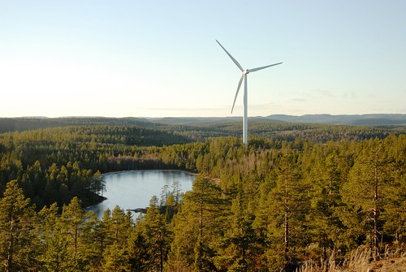
Objectives
To study wind power energy .
To study about geographical area .
AI models can analyze complex weather patterns and turbine data to predict wind speeds and energy output more precisely than traditional methods..

Slide 5
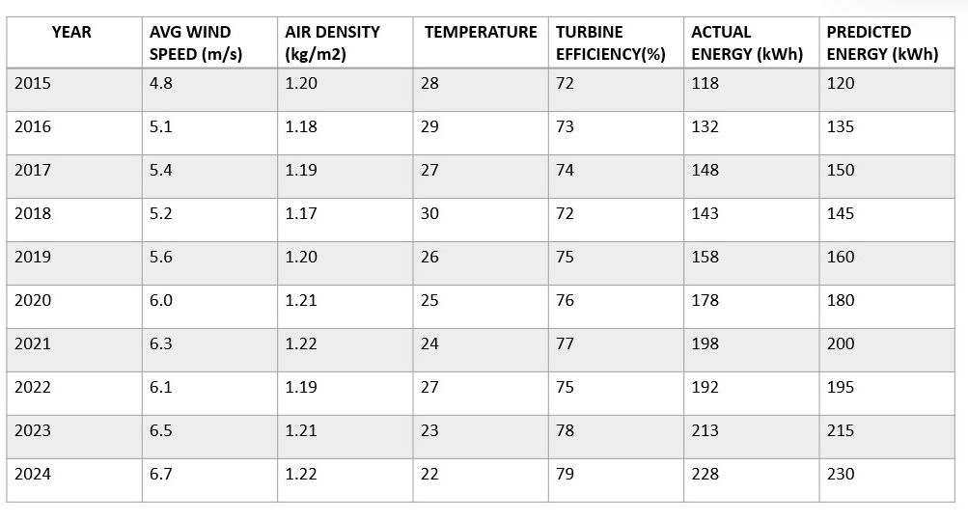
Dataset
WIND ENERGY DATASET FOR CHIKKAMANGALURU ( 2015 - 2024 )
Notes:
(

Slide 6
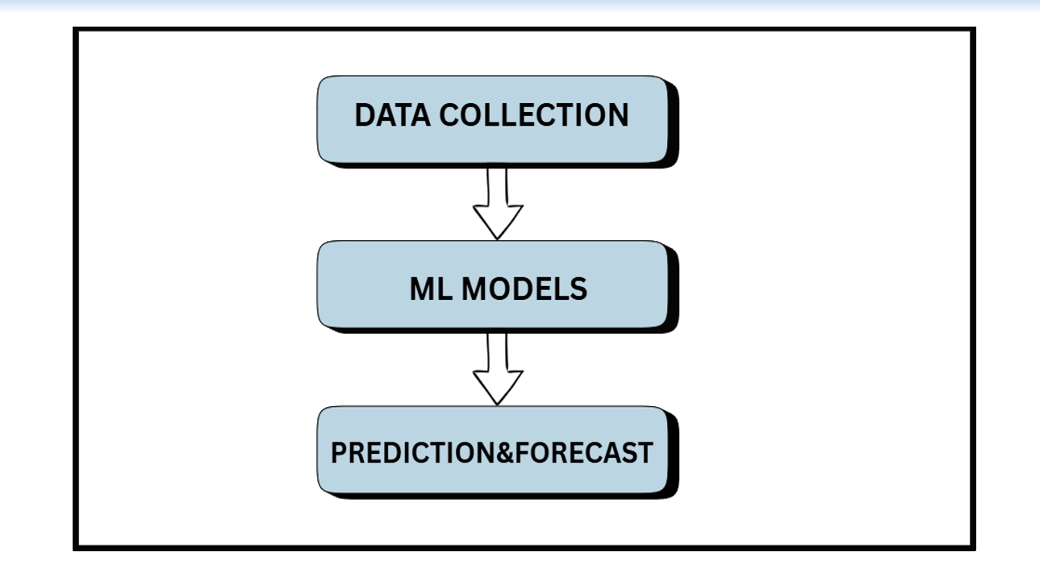
Methodology

Slide 7
RESULT
YEAR | PREDICTED ENERGY (kWh) | ACTUAL ENERGY (kWh) | ERROR
2015 | 120 | 118 | 2
2016 | 135 | 132 | 3
2017 | 150 | 148 | 2
2018 | 145 | 143 | 2
2019 | 160 | 158 | 2
2020 | 180 | 178 | 2
2021 | 200 | 198 | 2
2022 | 195 | 192 | 3
2023 | 215 | 213 | 2
2024 | 230 | 228 | 2

Slide 8
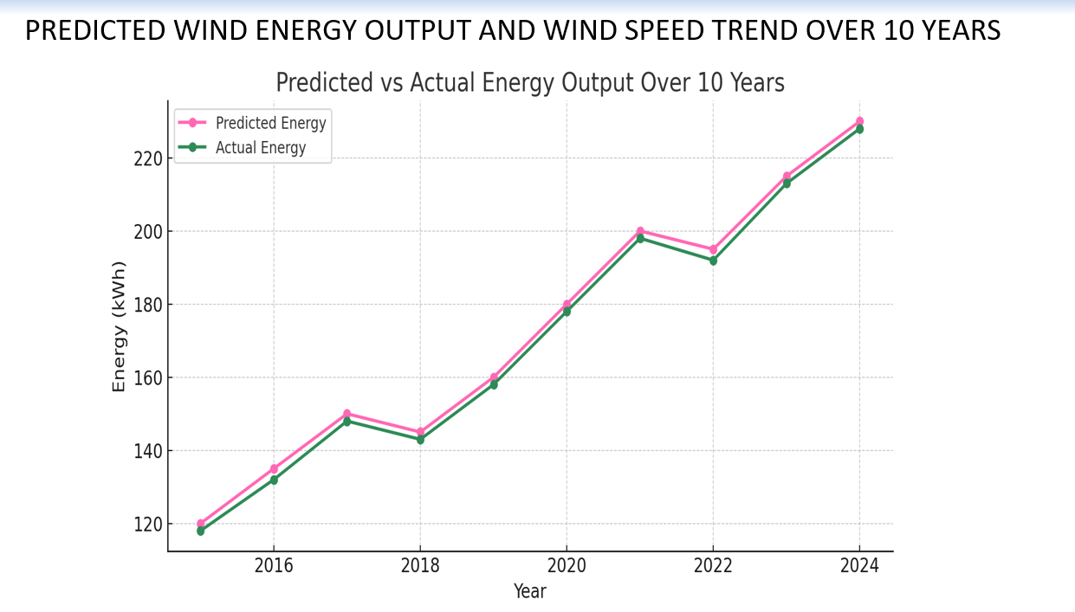
RESULT ANALYSIS

Slide 9
RESULT
YEAR | ACTUAL ENERGY (kWh) | LINEAR REGRESSION | RANDOM FOREST | GRADIENT BOOSTING | SVR (Support Vector Regression)
2015 | 118 | 120 | 124 | 123 | 121
2016 | 132 | 135 | 138 | 137 | 133
2017 | 148 | 150 | 152 | 150 | 146
2018 | 143 | 145 | 147 | 145 | 141
2019 | 158 | 160 | 169 | 166 | 160
2020 | 178 | 180 | 186 | 183 | 175
2021 | 198 | 200 | 207 | 203 | 195
2022 | 192 | 195 | 202 | 199 | 191
2023 | 213 | 215 | 226 | 222 | 212
2024 | 228 | 230 | 243 | 238 | 227

Slide 10
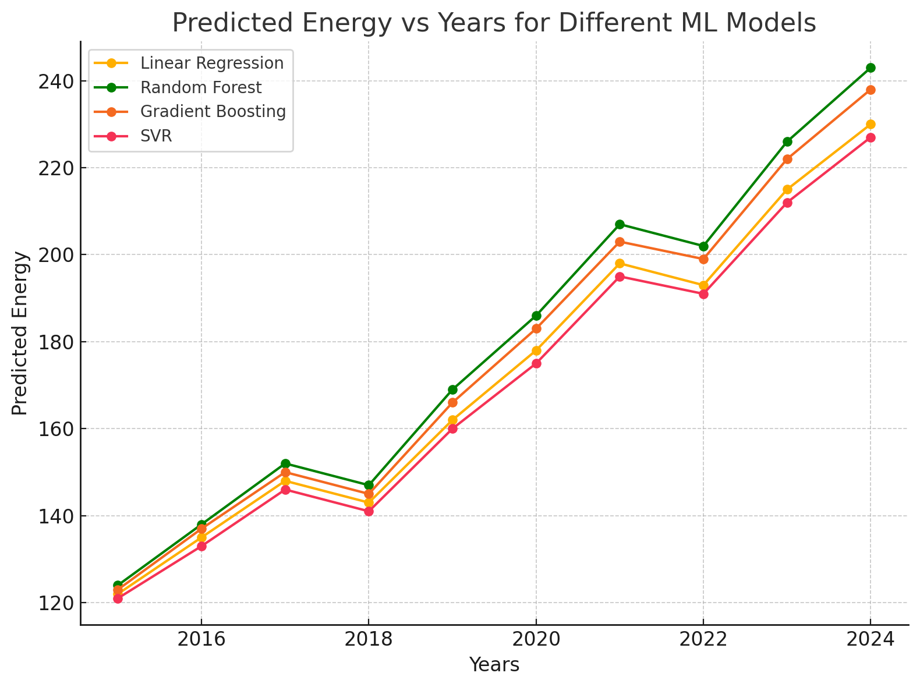
RESULT ANALYSIS

Slide 11
Conclusions
Four ML models has been used to predict the energy for past 10 years.
Linear Regression gave predictions closest to actual values .
Linear Regression provided the most accurate predictions for this dataset .
We conclude that Linear Regression more accurate model to predict wind energy using AI .

Slide 12


